Slide 1
Create a To-Do List App
Using Tkinter

Slide 2
First thing to note
Based on Past Errors
This is the order the code works:
root.mainloop() This is always at the bottom of the code

Slide 3
The Order of Todays Project
Your code should be written in this order
Necessary Imports
Apps Functions
Window Set Up
UI Layout

Slide 4
Necessary imports
import tkinter as tk
from tkinter import messagebox

Slide 5
Window Setup
root = tk.Tk()
root.title("To-Do List App")
root.geometry("420x450")
root.resizable(False, False)

Slide 6
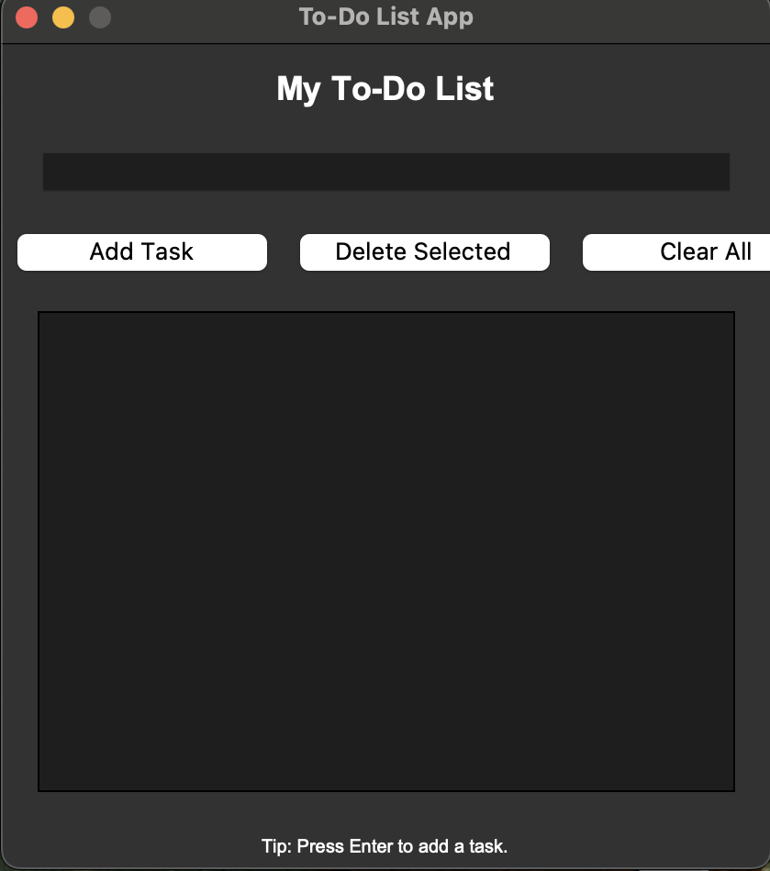
UI Layout
The Title Label
title_label = tk.Label(root,
text="My To-Do List", font=("Arial", 18, "bold"))
title_label.pack(pady=10)

Slide 7
UI Layout
Task Entry
task_entry = tk.Entry(root, font=("Arial", 12))
task_entry.pack(padx=20, pady=10, fill="x")
task_entry.bind("<Return>",
add_task_with_enter)

Slide 8
UI Layout
Button Frame
button_frame = tk.Frame(root)
button_frame.pack(pady=5)

Slide 9
UI Layout
Add Task
add_button = tk.Button(button_frame,
text="Add Task", width=12, command=add_task)
add_button.grid(row=0, column=0, padx=5)

Slide 10
UI Layout
Delete Selected Task
delete_button = tk.Button(button_frame, text="Delete Selected", width=12, command=delete_selected)
delete_button.grid(row=0, column=1, padx=5)

Slide 11
UI Layout
Clear All
clear_button = tk.Button(button_frame, text="Clear All", width=12, command=clear_all)
clear_button.grid(row=0, column=2, padx=5)

Slide 12
UI Layout
List Box
task_listbox = tk.Listbox(root, font=("Arial", 12),
height=15)
task_listbox.pack(padx=20, pady=15,
fill="both", expand=True)

Slide 13
UI Layout
Hint Label
hint_label = tk.Label(root,
text="Tip: Press Enter to add a task.",
font=("Arial", 10))
hint_label.pack(pady=5)

Slide 14
App Function
Add Task
def add_task():
task = task_entry.get().strip()
if not task:
messagebox.showwarning("Empty Task",
"Please enter a task.")
return
task_listbox.insert(tk.END, task)
task_entry.delete(0, tk.END)

Slide 15
App Function
Delete Selected Task
def delete_selected():
selected = task_listbox.curselection()
if not selected:
messagebox.showinfo("No Selection", "Select a task to delete.")
return
task_listbox.delete(selected[0])

Slide 16
App Function
Clear All
def clear_all():
if task_listbox.size() == 0:
messagebox.showinfo("Nothing to Clear",
"The list is already empty.")
return
if messagebox.askyesno("Confirm",
"Clear all tasks?"):
task_listbox.delete(0, tk.END)

Slide 17
App Function
Press enter to add task
def add_task_with_enter(event):
add_task()

